Slide 1

Sunday 6th November

Slide 2
We stand to sing
Gathering Hymn #250
All Creatures of our God and King

Slide 3
All creatures of our God and King,
lift up your voice and with us sing,
Alleluia, Alleluia!
Thou burning sun with golden beam,
thou silver moon with softer gleam:
O praise him, O praise him,
Alleluia, alleluia, alleluia!

Slide 4
Thou rushing wind that art so strong,
ye clouds that sail in heaven along,
O praise him, alleluia!
Thou rising morn, in praise rejoice;
ye lights of evening, find a voice:
O praise him, O praise him,
Alleluia, alleluia, alleluia!

Slide 5
Thou flowing water, pure and clear,
make music for thy Lord to hear,
Alleluia, Alleluia!
Thou fire, so masterful and bright,
that givest us both warmth and light:
O praise him, O praise him,
Alleluia, alleluia, alleluia!

Slide 6
And thou, most kind and gentle death,
waiting to hush our latest breath,
O praise him, alleluia!
Thou leadest home the child of God,
and Christ our Lord the way has trod:
O praise him, O praise him,
Alleluia, alleluia, alleluia!

Slide 7
Let all things their creator bless,
and worship him in humbleness;
O praise him, alleluia!
Praise, praise the Father, praise the Son,
and praise the Spirit, Three in One:
O praise him, O praise him,
Alleluia, alleluia, alleluia!

Slide 8
Gathering
In the name of the Father,
and of the Son,
and of the Holy Spirit.
All Amen.

Slide 9
Words of Welcome
Grace, mercy and peace
from God our Father
and the Lord Jesus Christ
be with you
All and also with you.

Slide 10
Prayers of Penitence
God the Father forgives us in Christ and heals us by the Holy Spirit.
Let us therefore put away all anger and bitterness, all slander and malice,
and confess our sins
to God our redeemer.

Slide 11
All Most merciful God,
Father of our Lord Jesus Christ,
we confess that we have sinned
in thought, word and deed.
We have not loved you with our whole heart.
We have not loved our neighbours as ourselves.

Slide 12
In your mercy
forgive what we have been,
help us to amend what we are,
and direct what we shall be;
that we may do justly,
love mercy,
and walk humbly with you, our God.
Amen.

Slide 13
Lord, have mercy.
All Lord, have mercy.
Christ, have mercy.
All Christ, have mercy.
Lord, have mercy.
All Lord, have mercy.

Slide 14
Absolution
Almighty God, who forgives all who truly repent,
have mercy upon you,
pardon and deliver you from all your sins,
confirm and strengthen you in all goodness,
and keep you in life eternal;
through Jesus Christ our Lord.
All Amen.

Slide 15
Gloria (Raemoir version)
We sing together
All Glory to God in the highest,
and peace to his people on earth.
Lord God, heavenly King,

Slide 16
almighty God and Father,
we worship you, we give you thanks,
we praise you for your glory.
(music break)
Lord Jesus Christ, only Son of the Father,
Lord God, Lamb of God,

Slide 17
you take away the sin of the world,
have mer—cy on us;
you are seated at the right hand of the Fa—ther
receive our prayer.
(music break)

Slide 18
For you alone are the Ho—ly One,
you alone are the Lord,
you alone are the Most High,
Je—sus Christ,
with the Ho—ly Spirit,

Slide 19

in the glory of God
the Fa—ther.
A—men, A—men.
Let us pray

Slide 20
Collect Prayer
Almighty Father, whose will is to restore all things in your beloved Son, the King of all:
govern the hearts and minds of those in authority, and bring the families of the nations, to be subject to his just and gentle rule; who is alive and reigns with you,
in the unity of the Holy Spirit,
one God, now and for ever.
All Amen.

Slide 21
The Liturgy of the Word
Old Testament – Job 19: 23-27
Oh, that my words were recorded, that they were written on a scroll, that they were inscribed with an iron tool on lead, or engraved in rock forever!

Slide 22
I know that my redeemer lives, and that in the end he will stand on the earth. And after my skin has been destroyed, yet in my flesh I will see God; I myself will see him with my own eyes—I, and not another. How my heart yearns within me!
This is the word of the Lord
All: Thanks be to God

Slide 23

Psalm – We repeat the refrain

Slide 24
New Testament
2 Thessalonians 2:1-3, 13-17
Concerning the coming of our Lord Jesus Christ and our being gathered to him, we ask you, brothers and sisters, not to become easily unsettled or alarmed by the teaching

Slide 25
allegedly from us—whether by a prophecy or by word of mouth or by letter—asserting that the day of the Lord has already come. Don’t let anyone deceive you in any way, for that day will not come until the rebellion occurs.
But we always thank God for you, brothers and sisters loved by the Lord,

Slide 26
because God chose you as first fruits to be saved through the sanctifying work of the Spirit and through belief in the truth.
He called you to this through our gospel, that you might share in the glory of our Lord Jesus Christ.

Slide 27
So then, brothers and sisters, stand firm and hold fast to the teachings we passed on to you, whether by word of mouth or by letter.
May our Lord Jesus Christ himself and God our Father, who loved us and by his grace gave us eternal encouragement and good hope,

Slide 28
encourage your hearts and strengthen you in every good deed and word.
This is the Word of the Lord
All: Thanks be to God

Slide 29
Gospel - We stand to hear the Gospel
Glory to the Father, and to the Son,
and to the Holy Spirit,
one God, who was, and who is,
and who is to come, the Almighty.
All: Alleluia, Alleluia, Alleluia x2

Slide 30
Gospel Greeting
Hear the Gospel of our Lord
according to Luke 20:27-38
All: Glory to you, O Lord. +

Slide 31
Some of the Sadducees, who say there is no resurrection, came to Jesus with a question.
“Teacher,” they said, “Moses wrote for us that if a man’s brother dies and leaves a wife but no children, the man must marry the widow and raise up offspring for his brother.

Slide 32
Now there were seven brothers.
The first one married a woman and died childless.
The second and then the third married her,
and in the same way the seven died, leaving no children. Finally, the woman died too.
Now then, at the resurrection whose wife will she be, since the seven were married to her?

Slide 33
Jesus replied, “The people of this age marry and are given in marriage.
But those who are considered worthy of taking part in the age to come and in the resurrection from the dead will neither marry nor be given in marriage, and they can no longer die; for they are like the angels.
They are God’s children, since they are children of the resurrection.

Slide 34
But in the account of the burning bush, even Moses showed that the dead rise, for he calls the Lord ‘the God of Abraham, and the God of Isaac, and the God of Jacob.’ He is not the God of the dead, but of the living, for to him all are alive.”
This is the Gospel of the Lord
All: Praise to you O Christ

Slide 35
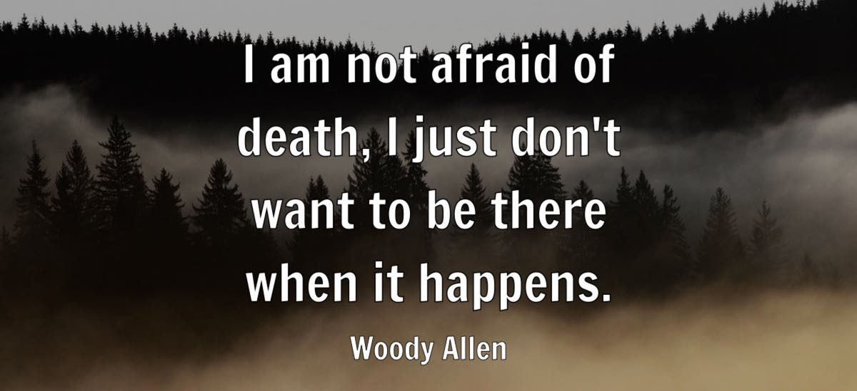
Sermon

Slide 36
Creed
We stand to affirm our Faith
All We believe in one God,
the Father, the Almighty,
maker of heaven and earth,
of all that is,
seen and unseen.

Slide 37
We believe in one Lord, Jesus Christ,
the only Son of God,
eternally begotten of the Father,
God from God, Light from Light,
true God from true God,
begotten, not made,
of one Being with the Father;
through him all things were made.

Slide 38
For us and for our salvation
he came down from heaven,
was incarnate from the Holy Spirit and the Virgin Mary and was made man.
For our sake he was crucified
under Pontius Pilate;
he suffered death and was buried.

Slide 39
On the third day he rose again
in accordance with the Scriptures;
he ascended into heaven
and is seated at the right hand of the Father.
He will come again in glory to judge the living and the dead,
and his kingdom will have no end.

Slide 40
We believe in the Holy Spirit,
the Lord, the giver of life,
who proceeds from the Father and the Son,
who with the Father and the Son
is worshipped and glorified,
who has spoken through the prophets.

Slide 41
We believe in one holy catholic
and apostolic Church.
We acknowledge one baptism for the forgiveness of sins.
We look for the resurrection of the dead,
and the life of the world to come.
Amen.

Slide 42
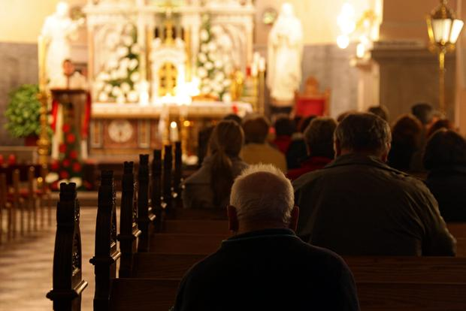
Prayers of Intercession
And at the end
Merciful Father,
accept these prayers
for the sake of your Son,
our Saviour Jesus Christ.
Amen.

Slide 43
The Peace
The Apostle Paul said: ‘Aim for perfection, be of one mind, live in peace. Greet one another with a holy kiss.’
The peace of the Lord be with you.
All : and also with you.
Let us offer one another a sign of peace.

Slide 44
We stand to sing
Offertory Hymn #557
Praise to the Holiest in the Height

Slide 45
Praise to the Holiest in the height,
and in the depth be praise:
in all his words most wonderful,
most sure in all his ways.

Slide 46
O loving wisdom of our God!
When all was sin and shame,
a second Adam to the fight
and to the rescue came.

Slide 47
O wisest love! that flesh and blood,
which did in Adam fail,
should strive afresh against the foe,
should strive and should prevail;

Slide 48
And that a higher gift than grace
should flesh and blood refine,
God’s presence and his very self,
and essence all-divine.

Slide 49
O generous love! that he,
who smote in Man for man the foe,
the double agony in Man
for man should undergo.

Slide 50
And in the garden secretly,
and on the cross on high,
should teach his brethren,
and inspire
to suffer and to die.

Slide 51
Praise to the Holiest in the height,
and in the depth be praise:
in all his words most wonderful,
most sure in all his ways.

Slide 52
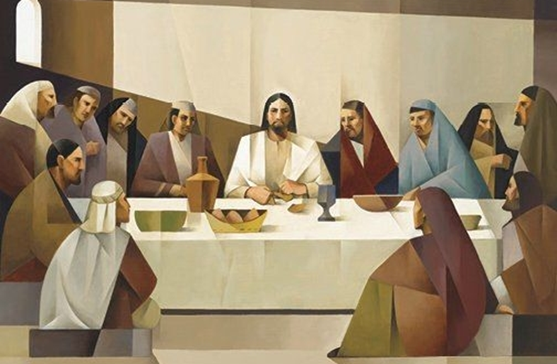
Eucharistic Prayer H
The Lord is here.
All His Spirit is with us.
Lift up your hearts.
All We lift them to the Lord.
Let us give thanks to the Lord our God.
All It is right to give thanks and praise.

Slide 53
It is right to praise you, Father, Lord of all creation;
in your love you made us for yourself.
When we turned away
you did not reject us,
but came to meet us in your Son.
All You embraced us as your children
and welcomed us to sit and eat with you.

Slide 54
In Christ you shared our life
that we might live in him and he in us.
All He opened his arms of love upon the cross
and made for all the perfect sacrifice for sin.
On the night he was betrayed,
at supper with his friends
he took bread, and gave you thanks;
he broke it and gave it to them, saying:

Slide 55
Take, eat; this is my body which is given for you;
do this in remembrance of me.
All Father, we do this in remembrance of him:
his body is the bread of life.
At the end of supper, taking the cup of wine,
he gave you thanks, and said:

Slide 56
Drink this, all of you; this is my blood of
the new covenant,
which is shed for you for the forgiveness of sins;
do this in remembrance of me.
All Father, we do this in remembrance of him:
his blood is shed for all.

Slide 57
As we proclaim his death and celebrate his
rising in glory,
send your Holy Spirit that this bread and this wine
may be to us the body and blood of your dear Son.
All As we eat and drink these holy gifts
make us one in Christ, our risen Lord.

Slide 58
With your whole Church
throughout the world
we offer you this sacrifice of praise
and lift our voice
to join the eternal song of heaven:

Slide 59
Sanctus (Holy holy) ()
We sing together
All Holy, holy, holy Lord, God of power and might, heaven and earth are full of your glory. Hosanna in the highest, highest, Hosanna in the highest.
Blessed is he who comes in the name of the Lord. Hosanna in the highest, highest.
Hosanna in the highest, the highest, the highest,
the highest.

Slide 60
The Lord’s Prayer
As our Saviour taught us, so we pray
All Our Father, who art in heaven, hallowed be thy name; thy kingdom come; thy will be done; on earth as it is in heaven. Give us this day our daily bread.

Slide 61
And forgive us our trespasses, as we forgive those who trespass against us.
And lead us not into temptation; but deliver us from evil. For thine is the kingdom, the power and the glory, for ever and ever. Amen.

Slide 62
Breaking of the Bread
The Minister breaks the consecrated bread.
We break this bread
to share in the body of Christ.
All Though we are many,
we are one body,
because we all share in one bread.

Slide 63
Lamb of God
All Lamb of God, you take away the sins of the world, have mercy on us.
Lamb of God, you take away the sin of the world, have mercy on us.
Lamb of God, you take away the sin of the world, grant us peace.
Congregation Kneels

Slide 64
Jesus is the Lamb of God
who takes away the sin of the world.
Blessed are those who are called to his supper.
All Lord, I am not worthy to receive you,
but only say the word,
and I shall be healed.

Slide 65
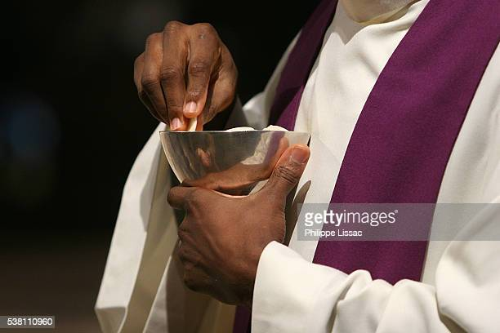
Distribution of Communion

Slide 66
We stand to sing
Communion Hymn
In Christ Alone

Slide 67
In Christ alone my hope is found,
he is my light, my strength, my song;
this cornerstone, this solid ground,
firm through the fiercest drought and storm.
What heights of love, what depths of peace,
when fears are stilled, when strivings cease!
My comforter, my all in all,
here in the love of Christ I stand.

Slide 68
In Christ alone! – who took on flesh,
fullness of God in helpless babe!
This gift of love and righteousness,
scorned by the ones he came to save:
till on that cross as Jesus died,
the wrath of God was satisfied –
for every sin on him was laid;
here in the death of Christ I live.

Slide 69
There in the ground his body lay,
light of the world by darkness slain:
then bursting forth in glorious day
up from the grave he rose again!
And as he stands in victory
sin’s curse has lost its grip on me,
for I am his and he is mine –
bought with the precious blood of Christ.

Slide 70
No guilt in life, no fear in death,
this is the power of Christ in me;
from life’s first cry to final breath,
Jesus commands my destiny.
No power of hell, no scheme of man,
can ever pluck me from his hand;
till he returns or calls me home,
here in the power of Christ I’ll stand!

Slide 71
Prayer after Communion
All Almighty God, we thank you for feeding us
with the body and blood of your Son
Jesus Christ. Through him we offer you
our souls and bodies to be a living sacrifice.
Send us out in the power of your Spirit
to live and work to your praise and glory.
Amen.

Slide 72

God of Mission,
who alone brings growth
to your church, send your Holy Spirit
To give Vision to our planning,
Wisdom to our Actions,
and Power to our Witness.
Help our church to grow in numbers,
in Spiritual Commitment to You,
And in Service to our local Community.
Through Jesus Christ our Lord. Amen.
The prayer
for

Slide 73
Post Communion Collect
God of peace,
whose Son Jesus Christ proclaimed the kingdom
and restored the broken to wholeness of life:
look with compassion on the anguish of the world, and by your healing power
make whole both people and nations;
through our Lord and Saviour Jesus Christ.
All: Amen

Slide 74



Slide 75
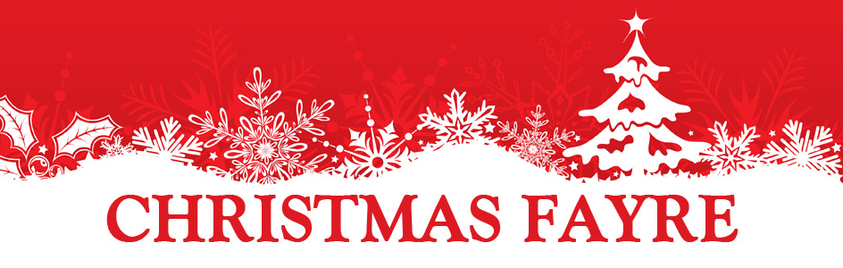



SATURDAY 3RD DECEMBER
Planning meeting after Monday Prayers
Prize Donations wanted please!

Slide 76

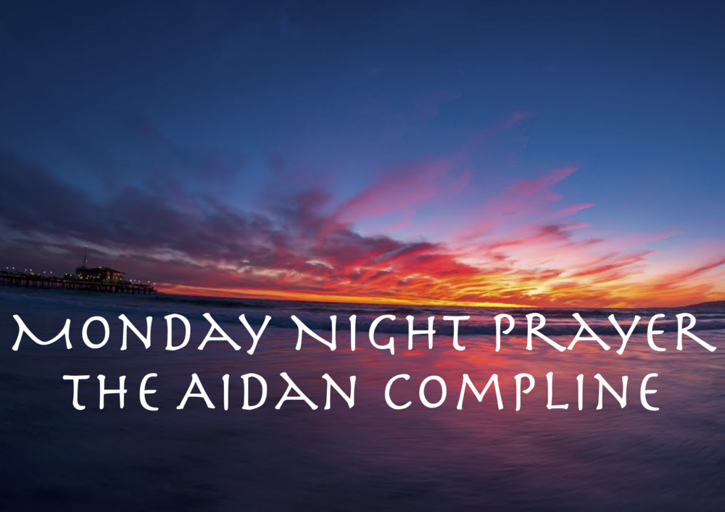
JOIN US AT 7PM
In the Lady Chapel

Slide 77
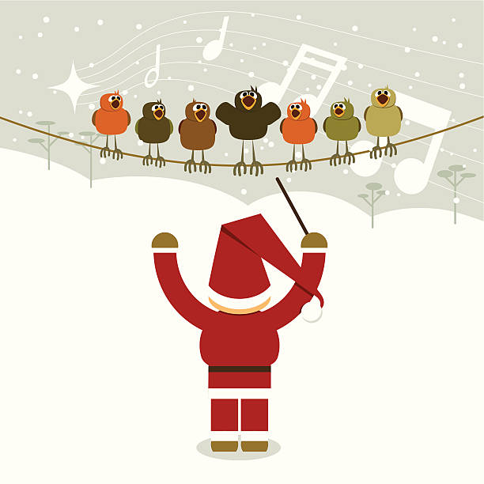


Christmas
Choir
Practice
Tuesdays
at 7pm

Slide 78
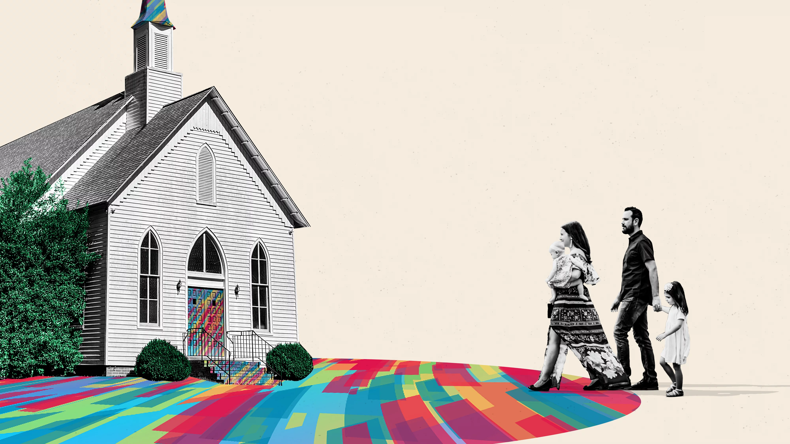
SATURDAY
FAMILY FELLOWSHIP
See Norma Naylor
for more details

Slide 79

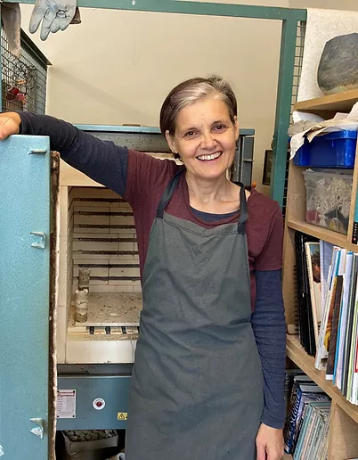
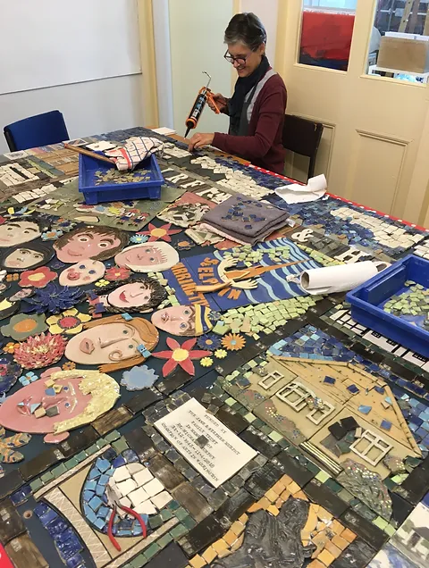
Come & Meet Debbie Podmore
*
Ceramics Artist
Wed 9am

Slide 80
Final Blessing
May the love of the Father, the tenderness of the Son, and the presence of the Spirit, gladden your heart and bring peace to your soul, this day and every day!
All Amen.

Slide 81

The Dismissal
Minister dismisses the people
Go in peace to love
and serve the Lord
All In the name of
Christ. Amen.

Slide 82
Exit Hymn #386
Be Thou My Vision

Slide 83
Be thou my vision,
O Lord of my heart,
be all else but naught to me,
save that thou art;
be thou my best thought
in the day and the night,
both waking and sleeping,
thy presence my light.

Slide 84
Be thou my wisdom,
be thou my true word,
be thou ever with me,
and I with thee, Lord;
be thou my great Father,
and I Thy true son;
be thou in me dwelling,
and I with thee one.

Slide 85
Be thou my, breastplate,
my sword for the fight;
Be thou my whole armour,
be thou my true might;
be thou my soul’s shelter,
be thou my strong tower;
O raise thou me heavenward,
great Power of my power.

Slide 86
Riches I need not,
nor man’s empty praise,
be thou mine inheritance,
now and always:
be thou and thou only,
the first in my heart;
O Sovereign of heaven,
my treasure thou art.

Slide 87
High King of heaven,
thou heaven’s bright Sun
Grant me its joys after vict’ry is won;
great heart of my own heart,
whatever befall,
still be thou my vision,
O Ruler of all.

Slide 88




